Slide 1
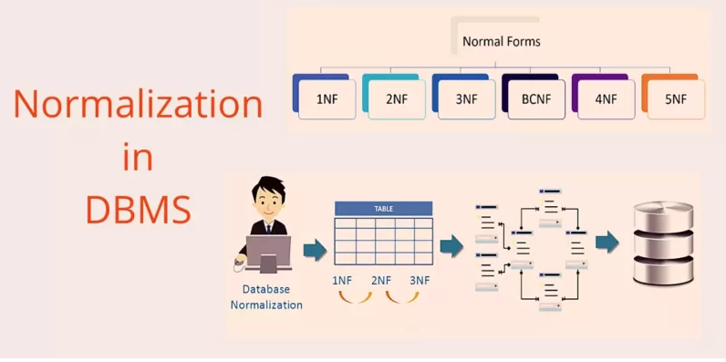
UNIT III
Database Design
Transaction Processing Concepts
Notes:
https://forms.gle/aesC8WbJBZeQTjaJ8

Slide 2
CONTENT
Database Design: Informal Design Guidelines for Relation Schemas; Functional Dependencies; Normal Forms Based on Primary Keys; General Definitions of Second and Third Normal Forms; Boyce-Codd Normal Form.
Transaction Processing Concepts: Introduction to Transaction processing, Transaction and System concepts, Desirable properties of Transactions and issues with concurrent transactions. 2PL and TSO algorithms.
SELF STUDY: Database recovery techniques

Slide 3
Course Learning Objective:
To introduce formal database design approach through normalization and discuss various normal forms.
Course Outcome (CO)
CO3: Apply the concepts of Normalization and design database which eliminates all anomalies.
CO5: Explain the issues of concurrency control and algorithm to address the problems in concurrent transaction processing.

Slide 4
INTRODUCTION
Each relation schema consists of a number of attributes, and
A relational database schema consists of a number of relation schemas.
Attributes are grouped to form a relation schema :
      by using the common sense of the database designer or
      by mapping a database schema design from a conceptual data model such as the ER or Enhanced-ER (EER) data model.
    These models make the designer identify entity types and relationship types and their respective attributes, which leads to a natural and logical grouping of the attributes into relations when the mapping procedures are followed.
  There is a need for some formal way of analyzing why one grouping of attributes into a relation schema may be better than another.
Notes:
we discuss some of the theory that has been developed with the goal of evaluating relational schemas for design quality—that is, to measure formally why one set of groupings of attributes into relation schemas is better than another

Slide 5
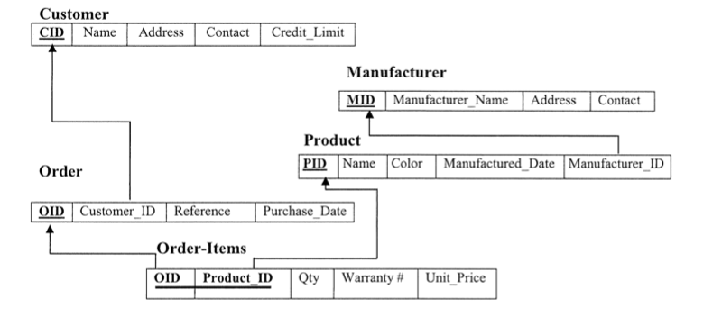
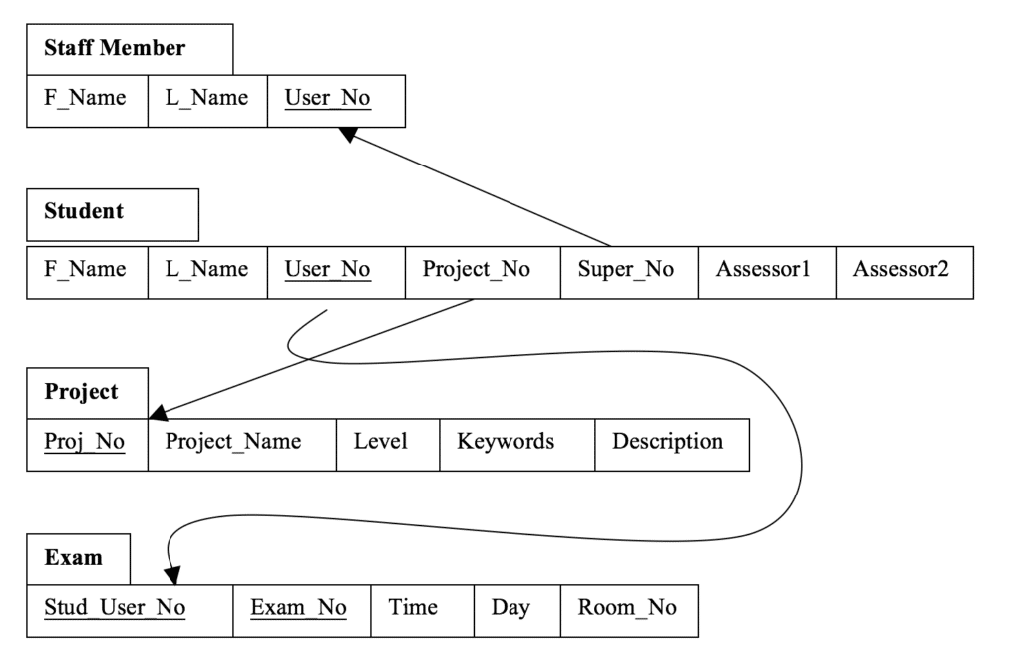
Sample Relational Schema

Slide 6
Informal Design Guidelines for Relational Databases
Four informal guidelines that may be used as measures to determine the quality of relation schema design:
  ■ Making sure that the semantics of the attributes is clear in the schema
  ■ Reducing the redundant information in tuples
  ■ Reducing the NULL values in tuples
  ■ Disallowing the possibility of generating spurious tuples
Notes:
Before discussing the formal theory of relational database design, we discuss four informal guidelinesthat may be used as measures to determine the quality of relation schema design:■Making sure that the semantics of the attributes is clear in the schema■Reducing the redundant information in tuples■Reducing the NULLvalues in tuples■Disallowing the possibility of generating spurious tuples

Slide 7
Imparting Clear Semantics to Attributes in Relations
The semantics of a relation refers to its meaning resulting from the interpretation of attribute values in a tuple - the relational schema design should have a clear meaning.
Whenever we group attributes to form a relation schema, we assume that:
  attributes belonging to one relation have certain real-world meaning and
  a proper interpretation associated with them.
In general, the easier it is to explain the semantics of the relation, the better the relation schema design will be.

Slide 8
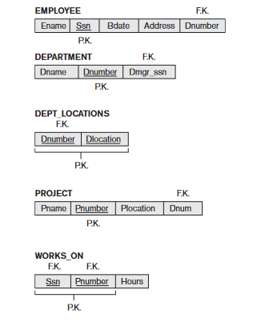
Imparting Clear Semantics to Attributes in Relations
The meaning of the EMPLOYEE relation schema is quite simple: Each tuple represents an employee, with values for the employee’s name (Ename), Social Security number(Ssn), birth date (Bdate), and address (Address), and the number of the department that the employee works for (Dnumber). The Dnumber attribute is a foreign key that represents an implicit relationship between EMPLOYEE and DEPARTMENT.
The semantics of the DEPARTMENT and PROJECT schemas are also straightforward: Each DEPARTMENT tuple represents a department entity, and each PROJECT tuple represents a project entity. The attribute Dmgr_ssn of DEPARTMENT relates a department to the employee who is its manager, while Dnum of PROJECT relates a project to its controlling department; both are foreign key attributes.
The ease with which the meaning of a relation’s attributes can be explained is an informal measure of how well the relation is designed.

Slide 9
Imparting Clear Semantics to Attributes in Relations
Hence, all the relation schemas may be considered as easy to explain and therefore good from the standpoint of having clear semantics.
We can thus formulate the following informal design guideline (Guideline 1):
Design a relation schema so that it is easy to explain its meaning. Do not combine attributes from multiple entity types and relationship types into a single relation.
If a relation schema corresponds to one entity type or one relationship type, it is straightforward to interpret and to explain its meaning.
Otherwise, if the relation corresponds to a mixture of multiple entities and relationships, semantic ambiguities will result and the relation cannot be easily explained

Slide 10

Imparting Clear Semantics to Attributes in Relations
The relation schemas also has a clear semantics.
A tuple in the EMP_DEPT relation schema in represents a single employee but includes additional information—namely, the name (Dname) of the department for which the employee works and the SocialSecurity number (Dmgr_ssn) of the department manager.
It violates Guideline 1 by mixing attributes from distinct real-world entities: EMP_DEPT mixes attributes of employees and departments,
Hence, they fare poorly against the above measure of design quality.

Slide 11
Redundant Info. in Tuples & Update Anomalies
Mixing attributes of multiple entities may cause problems
Information is stored redundantly wasting storage
Leads to an additional problem referred to as “update anomalies” , which can be classified into :
    Insertion anomalies
        Deletion anomalies
        Modification anomalies
    It is easy to see that these three anomalies are undesirable and cause difficulties to maintain consistency of data as well as require unnecessary updates that can be avoided; hence, we can state the next guideline as follows

Slide 12
EXAMPLE OF AN UPDATE ANOMALY
Consider the relation:
EMP_PROJ ( Emp#, Proj#, Ename, Pname, No_hours)
Update Anomaly: Changing the name of project number P1 from “Billing” to “Customer-Accounting” may cause this update to be made for all 100 employees working on project P1.
Insert Anomaly: Cannot insert a project unless an employee is assigned to .
Inversely - Cannot insert an employee unless an he/she is assigned to a project.
Delete Anomaly: When a project is deleted, it will result in deleting all the employees who work on that project. Alternately, if an employee is the sole employee on a project, deleting that employee would result in deleting the corresponding project.

Slide 13
GUIDELINE 2:
Design a schema that does not suffer from the insertion, deletion and update anomalies. If there are any present, then note them so that applications can be made to take them into account

Slide 14
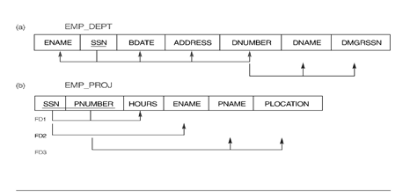
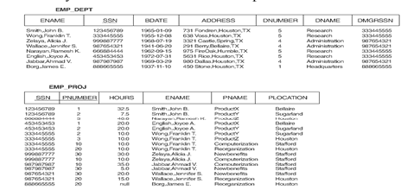
Relation schemas suffering from update anomalies

Slide 15
Null Values in Tuples
In some schema designs we may group many attributes together into a “fat” relation.
If many of the attributes do not apply to all tuples in the relation, we end up with many NULLs in those tuples.
  This can waste space at the storage level
  lead to problems with understanding the meaning of the attributes
  specifying JOIN operations at the logical level.
    SELECT and JOIN operations involve comparisons; if NULL values are present, the results may become unpredictable.
  Another problem with NULLs is how to account for them when aggregate operations such as COUNT or SUM are applied .
  Moreover, NULLs can have multiple interpretations:

Slide 16
Null Values in Tuples
■ The attribute does not apply to this tuple.
For example,Visa_status may not apply to U.S. students.
■ The attribute value for this tuple is unknown.
For example, the Date_of_birthmay be unknown for an employee.
■ The value is known but absent; that is, it has not been recorded yet.
For example, the Home_Phone_Numberfor an employee may exist, but may not be available and recorded yet.
Having the same representation for all NULLs compromises the different meanings they may have.
Therefore, we may state another guideline.

Slide 17
GUIDELINE 3:
As far as possible, avoid placing attributes in a base relation whose values may frequently be NULL. If NULLs are unavoidable, make sure that they apply in exceptional cases only and do not apply to a majority of tuples in the relation

Slide 18
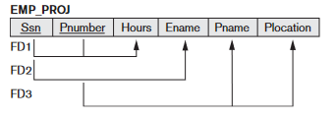
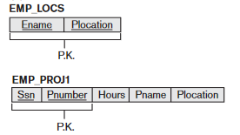
Generation of Spurious Tuples

Slide 19
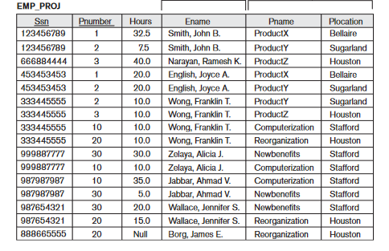
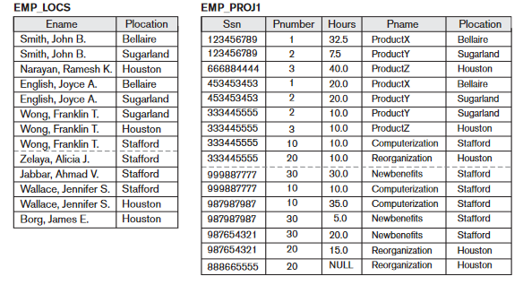

Slide 20
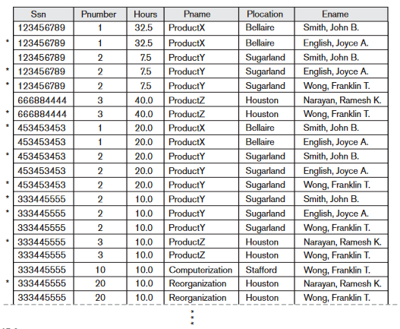
Suppose that we wish to recover the information that was originally in EMP_PROJ from EMP_PROJ1 and EMP_LOCS by using EMP_PROJ1 and EMP_LOCS as the base relations.
  If we attempt a NATURAL JOIN operation on EMP_PROJ1 and EMP_LOCS, the result produces many more tuples than the original set of tuples in EMP_PROJ.
Result of applying NATURAL JOIN to the tuples above the dashed lines in EMP_PROJ1 and EMP_LOCS of
Generated spurious tuples are marked by asterisks.
Notes:
Decomposing EMP_PROJ into EMP_LOCSandEMP_PROJ1is undesirable because when we JOIN them back using NATURAL JOIN, we do not get the correct original information. This is because in this case Plocation is the attribute that relatesEMP_LOCSandEMP_PROJ1, and Plocation is neither a primary key nor a foreign key in either EMP_LOCSorEMP_PROJ1. We can now informally state another design guideline.

Slide 21
Generation of Spurious Tuples
GUIDELINE 4:
Design relation schemas so that they can be joined with equality conditions on attributes that are appropriately related (primary key, foreign key) pairs in a way that guarantees that no spurious tuples are generated. Avoid relations that contain matching attributes that are not (foreign key, primary key) combinations because joining on such attributes may produce spurious tuples.

Slide 22
UNIT III
DATABASE DESIGN
Notes:
https://forms.gle/5o25rUnbLi9Wd8RK7

Slide 23
CONTENT
Database Design
Informal Design Guidelines for Relation Schemas;
Functional Dependencies;
Normal Forms Based on Primary Keys;
General Definitions of Second and Third Normal Forms.

Slide 24
RECAP
The four informal Guidelines to measures the quality of relational schema design are:
Guideline 1: Semantic of Relation Attributes
Guideline 2: Reducing the Redundant Values in Tuples
Guideline 3: Reducing the Null Values in Tuples
Guideline 4: Disallowing Generating Spurious Tuples

Slide 25
Functional Dependencies
Formal tool for analysis of relational schemas.
Functional dependencies (FDs) are used to specify formal measures of the "goodness" of relational designs
FDs and keys are used to define normal forms for relations.
A FD is a constraint between two sets of attributes from the database.
  The FD is a relationship that exists between two attributes.
  It typically exists between the primary key and non-key attribute within a table.
FD = a constraint between two attributes or two sets of attributes.

Slide 26
Functional Dependencies
FDs are constraints that are derived from the meaning and interrelationships of the data attributes.
A FD is a property of the meaning or semantics of the attributes, I.e., a property of the relation schema.
  They must hold on all relation states (extensions) of R.
  Relation extensions r(R) that satisfy the FD are called legal extensions.
If X and Y are two sets of attributes of R (X and Y are subsets of R) , FD is denoted by:
X → Y
    If X → Y, we say X functionally determines Y or Y is functionally dependent on X.
    The left side of the above FD diagram is called the determinant, and the right side is the dependent.
  An attribute may be functionally dependent on two or more attributes
Notes:
A functional dependency, denoted by X → Y, between two sets of attributes X and Y (X and Y are subsets of R) specifies a constraint on the possible tuples that can form a relation instance r of R: for any two tuples t1 and t2 in r such that t1[X]= t2[X], we must have t1[Y]= t2[Y].

Slide 27
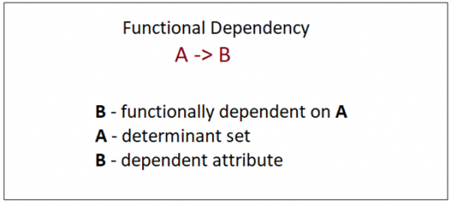
Functional Dependencies
A set of attributes A functionally determines a set of attributes B if the value of A determines a unique value for Y - if for any two tuples t₁ and t₂ in r that have t₁[A]= t₂[A], they must also have t₁[B]= t₂[B].

Slide 28
Functional Dependencies
Examples:
ISBN → Title
      indicates that ISBN determines Title.
SIN, Course → DateCompleted
      SIN and Course determine the date completed
      Emp_Id → Emp_Name
      Emp_Name is functionally dependent on Emp_Id.
      DeptId → DeptName
      DeptId is functionally determines DeptName

Slide 29
Functional Dependencies
Given a populated relation
  Cannot determine which FDs hold and which do not.
  Unless meaning of and relationships among attributes is known
  Can state that FD does not hold if there are tuples that show violation of such an FD.
The database designers will use their understanding of the semantics of the attributes of R—that is, how they relate to one another—to specify the functional dependencies that should hold on all relation states (extensions) r of R.
FDs are determined by semantics & are derived from the real-world constraints on the attributes.
  You can’t say that a FD exists just by looking at data.
  But can say whether it does not exist by looking at data.

Slide 30
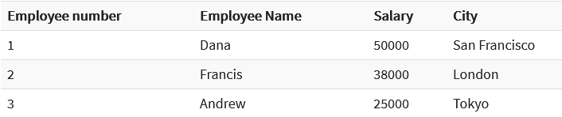
Functional Dependencies
Example:
In this example do the following FD’s hold ?
1) Employee number -> Employee Name
2) Employee number -> city
3) Employee number -> salary
We can say that the city, Employee Name, and salary are functionally depended on Employee number i.e., Employee number -> {Employee Name , city, salary}
There is a FD from the primary key to each of the other attributes in a table.
✓
✓

Slide 31
Functional Dependencies
Example:
4) Employee Name -> salary
5) Employee Name -> City
6) Salary -> City
4 | Andrew | 30000 | London
5 | Francis | 30000 | NYC
X
X
X

Slide 32
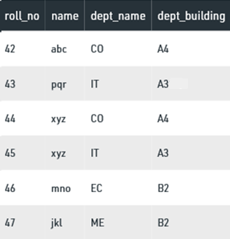
Functional Dependencies
Some valid FD’s:
roll_no → name
roll_no → dept_name
roll_no → dept_building
roll_no → { name, dept_name, dept_building }
dept_name → dept_building
{roll_no, name} ⇢ {dept_name, dept_building} etc
FD’s that do not hold:
name → dept_name
name → dept_building
dept_building → dept_name
dept_name, dept_building → name
name → roll_no,
{name, dept_name} → roll_no,
dept_building → roll_no etc.
Example:
Identify some valid FD’s .

Slide 33
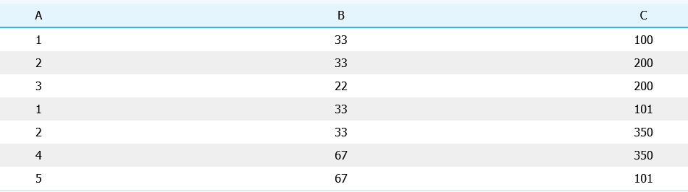
Functional Dependencies
Consider the table with attributes A, B and C
Suppose there are many more rows that are not shown.
1) Is there a functional dependency from B to A? Explain your answer.
For row 1 & 2 : t1 [B] = 33 = t2[B]
but t1[A] =1 & t2[A] = 2 => t1[A] ≠ t2[A]
Therefore FD B-> A does not hold.
2) The rows that are shown suggest there could be a functional dependency A → B ?

Slide 34
Functional Dependencies
Consider the following Department and Course tables :
  DEPARTMENT
  COURSE
deptCode → deptName deptCode, courseNo →title
deptCode → deptLocn deptCode, courseNo →description
deptCode → deptPhone deptCode, courseNo → credit hours
deptCode → chairName
deptCode | deptName | deptLocn | deptPhone | chairName
deptCode | courseNo | title | description | creditHours

Slide 35
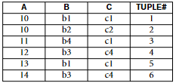
Functional Dependencies
Consider the following relation:
Given the previous extension (state), which of the following dependencies may hold in the above relation? If the dependency cannot hold, explain why by specifying the tuples that cause the violation.
I .A→B,
ii. B→C,
Iii .C→B,
iv. B→A,
v. C→A

Slide 36

Functional Dependencies
All addresses in the same town have the same zip code

Slide 38
NORMAL FORMS
08-07-21
Notes:
https://forms.gle/xqrDCeEvhWrFfJVZ6

Slide 39
WHY NORMALIZATION?
Database is a storage for the structured collection of data.
These data can be stored, accessed and manipulated across various locations within the database.
The wide range of storage leads to the problem of data redundancy - wherein a piece of the same data information is stored or replicated in multiple locations within the database.
Database with redundancy is at a disadvantage w.r.t to its storage, consistency and data manipulation.
Redundancy in relation may cause insertion, deletion and updation anomalies.
So, it helps to minimize the redundancy in relations.
Normalization in DBMS is the process of effectively organizing data into multiple relational tables to minimize data redundancy and ensure data is stored logically.
Notes:
The purpose of Normalisation in SQL is to eliminate redundant (repetitive) data and ensure data is stored logically.

Slide 40
WHY NORMALIZATION?
The inventor of the relational model E.F. Codd proposed the theory of normalization of data with the introduction of the First Normal Form, and he continued to extend theory with Second and Third Normal Form.
Later he joined Raymond F. Boyce to develop the theory of Boyce-Codd Normal Form.
The Theory of Data Normalization is still being developed further. For example, there are discussions even on 6th Normal Form.
However, in most practical applications, normalization achieves its best in 3rd Normal Form.
The evolution of Normalization in SQL theories is illustrated below-
Notes:
The purpose of Normalisation in SQL is to eliminate redundant (repetitive) data and ensure data is stored logically.

Slide 41
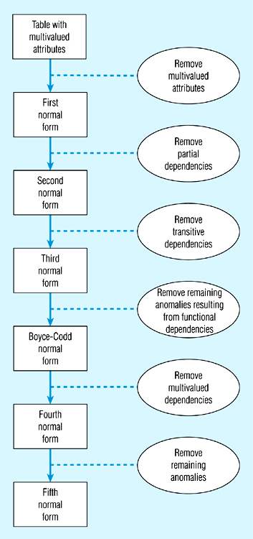
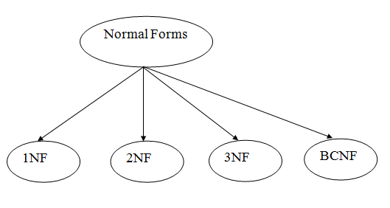
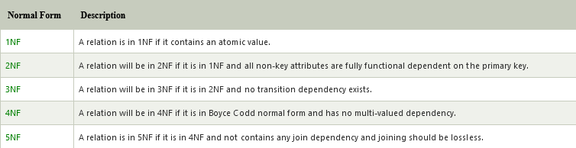

Slide 42
FIRST NORMAL FORM -1NF
1NF states that the:
domain of an attribute must include only atomic(simple, indivisible) values and that the value of any attribute in a tuple must be a single value from the domain of that attribute.
Hence, 1NF disallows having a set of values, a tuple of values, or a combination of both as an attribute value for a single tuple.
In other words, 1NF disallows relations within relations or relations as attribute values within tuples.
First normal form - allows only atomic (or indivisible) values
- disallows the multi-valued attribute, composite attribute, and their combinations.
Notes:
A relation will be 1NF if it contains an atomic value.
It states that an attribute of a table cannot hold multiple values. It must hold only single-valued attribute.
First normal form disallows the multi-valued attribute, composite attribute, and their combinations.

Slide 43
FIRST NORMAL FORM (1NF)
1NF states that the:
domain of an attribute must include only atomic (simple, indivisible) values and that the value of any attribute in a tuple must be a single value from the domain of that attribute.
Hence, 1NF disallows having a set of values, a tuple of values, or a combination of both as an attribute value for a single tuple.
In other words, 1NF disallows relations within relations or relations as attribute values within tuples.
First normal form - allows only atomic (or indivisible) values
- disallows the multi-valued attribute, composite attribute, and their combinations.
Notes:
Step 1 of the Normalization process
A relation will be 1NF if it contains an atomic value.
It states that an attribute of a table cannot hold multiple values. It must hold only single-valued attribute.
First normal form disallows the multi-valued attribute, composite attribute, and their combinations.

Slide 44
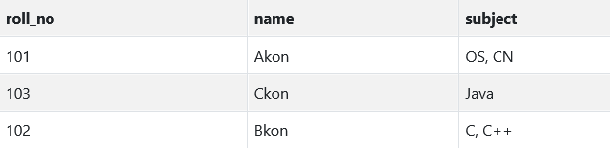
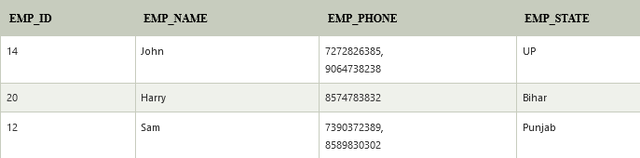
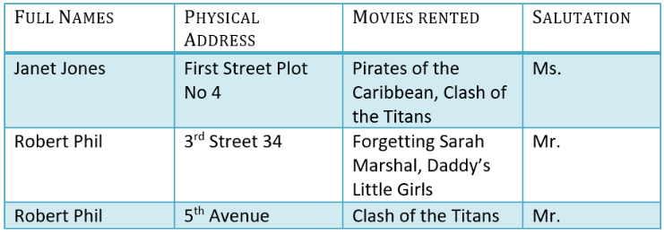
FIRST NORMAL FORM (1NF)

Slide 45
TECHNIQUES TO ACHIEVE 1NF
There are three main techniques to achieve first normal form for such a relation
1.Remove the attribute that violates 1NF and place it in a separate relation along with the primary key of the original relation.
2. Expand the key so that there will be a separate tuple in the original. In this case, the primary key becomes a composite key.
  This solution has the disadvantage of introducing redundancy in the relation.
3.I f a maximum number of values is known for the attribute—for example, if it is known that at most three locations can exist for a department—replace the Dlocations attribute by three atomic attributes:Dlocation1,Dlocation2, and Dlocation3.
  This solution has the disadvantage of introducing NULL values if most departments have fewer than three locations.
Notes:
Step 1 of the Normalization process
A relation will be 1NF if it contains an atomic value.
It states that an attribute of a table cannot hold multiple values. It must hold only single-valued attribute.
First normal form disallows the multi-valued attribute, composite attribute, and their combinations.

Slide 46


EXAMPLE
A relation schema that is not in 1NF
Sample state of relation DEPARTMENT

Slide 47

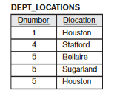
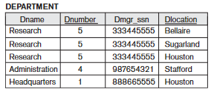
EXAMPLE
Technique # 1
Technique #2 Technique # 3
Dname | Dnumber | Dmgr_ssn | DLocation1 | DLocation2 | DLocation3
Research | 5 | 333445555 | Bellaire | Sugarland | Houston
Administration | 4 | 987654321 | Stafford
Headquarters | 1 | 899665555 | Houston

Slide 48
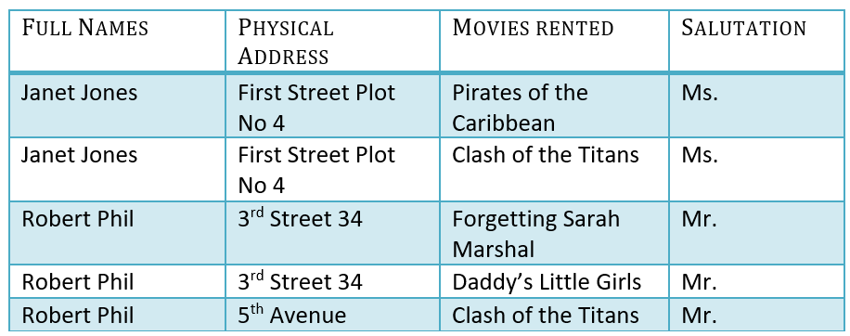
FIRST NORMAL FORM (1NF)

Slide 49
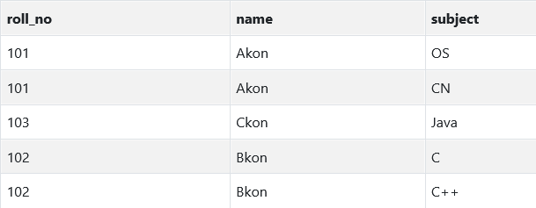
FIRST NORMAL FORM (1NF)

Slide 50
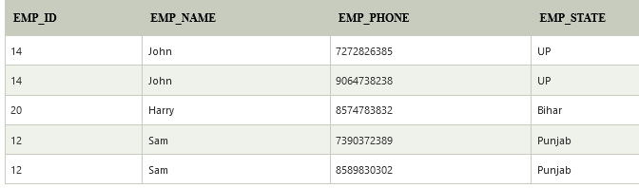
FIRST NORMAL FORM (1NF)

Slide 51
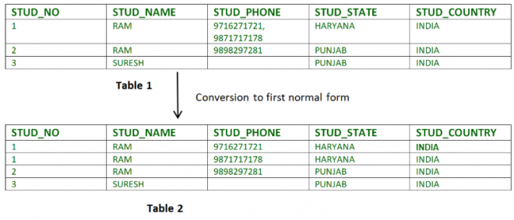
FIRST NORMAL FORM (1NF)

Slide 52
NORMAL FORMS
10-07-21
Notes:
https://forms.gle/MGXbUPZjKhS7hft36

Slide 53
SECOND NORMAL FORM - 2NF
Definition:
Relational must be in 1NF.
All non-key attributes are fully functional dependent on the primary key
The test for 2NF involves testing for functional dependencies whose left-hand side attributes are part of the primary key. If the primary key contains a single attribute, the test need not be applied at all.
Technique:
If a relation schema is not in 2NF, it can be second normalized or 2NF normalized into a number of 2NF relations in which nonprime attributes are associated only with the part of the primary key on which they are fully functionally dependent.
Notes:
Step 1 of the Normalization process
A relation will be 1NF if it contains an atomic value.
It states that an attribute of a table cannot hold multiple values. It must hold only single-valued attribute.
First normal form disallows the multi-valued attribute, composite attribute, and their combinations.

Slide 54
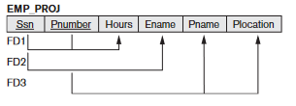
SECOND NORMAL FORM - 2NF
Example :
FD1 : Ssn, Pnumber -> Hours FD2: Ssn -> Ename FD3: Pnumber -> Pname, Plocation
The EMP_PROJ relation is in 1NF but is not in 2NF.
The nonprime attribute Ename violates 2NF because of FD2,as do the nonprime attributes Pname and Plocation because ofFD3. The functional dependencies FD2 and FD3 make Ename, Pname, and Plocation partially dependent on the primary key {Ssn,Pnumber} of EMP_PROJ, thus violating the 2NF test.

Slide 55
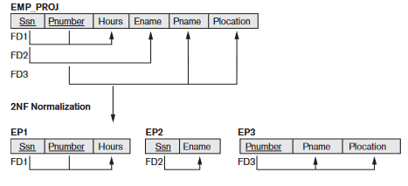
SECOND NORMAL FORM - 2NF
The functional dependencies FD1,FD2, and FD3 lead to the decomposition of EMP_PROJ into the three relation schemas EP1,EP2, and EP3 shown in Figure below , each of which is in 2NF.

Slide 56
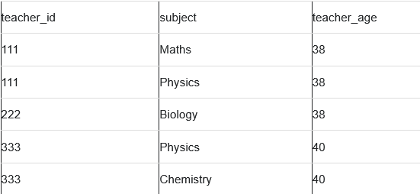
SECOND NORMAL FORM - 2NF
Suppose a school wants to store the data of teachers and the subjects they teach. They create a table that looks like this:
Since a teacher can teach more than one subjects, the table can have multiple rows for a same teacher.
Candidate Keys: {teacher_id, subject}
Non prime attribute: teacher_age

Slide 57
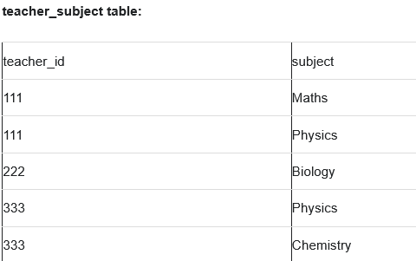
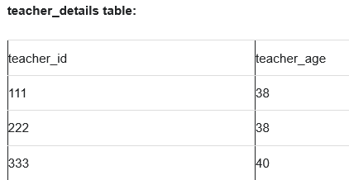
SECOND NORMAL FORM - 2NF
The table is in 1 NF because each attribute has atomic values.
However, it is not in 2NF because non prime attribute teacher_age is dependent on teacher_id alone which is a proper subset of candidate key. This violates the rule for 2NF as the rule says “no non-prime attribute is dependent on the proper subset of any candidate key of the table”.
To make the table complies with 2NF we can break it in two tables like this:

Slide 58
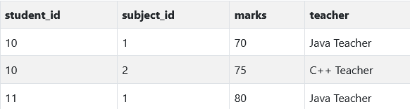
SECOND NORMAL FORM - 2NF
Consider the following Score table:
Candidate Key: {student_id + subject_id}
Non prime attribute: marks, teacher_age
Notes:
We have a column names teacher which is only dependent on the subject, for Java it's Java Teacher and for C++ it's C++ Teacher & so on.
Now as we just discussed that the primary key for this table is a composition of two columns which is student_id & subject_id but the teacher's name only depends on subject, hence the subject_id, and has nothing to do with student_id.
This is Partial Dependency, where an attribute in a table depends on only a part of the primary key and not on the whole key.

Slide 60
https://www.javatpoint.com/dbms-second-normal-form
https://www.geeksforgeeks.org/normal-forms-in-dbms/
https://www.studytonight.com/dbms/second-normal-form.php
https://beginnersbook.com/2015/05/normalization-in-dbms/
https://www.guru99.com/database-normalization.html

Slide 61
NORMAL FORMS
12-07-21
Notes:
https://forms.gle/6bTan73ViUBeztoEA

Slide 62
THIRD NORMAL FORM -3NF
Although 2NF relations have less redundancy than those in 1NF, they may still suffer from update anomalies - If we update only one tuple and not the other, the database would be in an inconsistent state.
This update anomaly is caused by a transitive dependency.
We need to remove such dependencies by progressing to Third Normal Form (3NF).
When a table is in the Second Normal Form and has no transitive dependency, then it is in the Third Normal Form.
For a table to be in the third normal form,
    It should be in the Second Normal form.
    And it should not have Transitive Dependency.

Slide 63
THIRD NORMAL FORM -3NF
Note –
  If A->B and
  B->C are two FDs
  then A->C is called transitive dependency.

Slide 64
TECHNIQUE TO ACHIEVE 3NF
The normalization of 2NF relations to 3NF involves the removal of transitive dependencies.
If a transitive dependency exists, we remove the transitively dependent attribute(s) from the relation by placing the attribute(s) in a new relation along with a copy of the determinant.

Slide 65
NOTE
Third Normal Form (3NF) is considered adequate for normal relational database design because most of the 3NF tables are free of insertion, update, and deletion anomalies.
Moreover, 3NF always ensures functional dependency preserving and lossless.

Slide 66
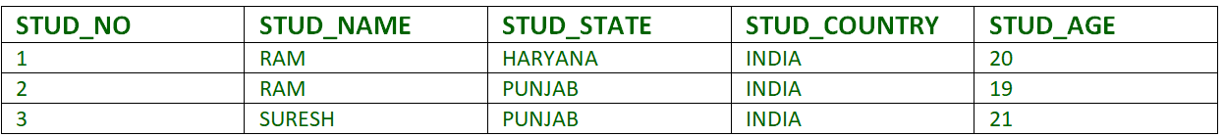
EXAMPLE
  FD set:
  {STUD_NO -> STUD_NAME,
  STUD_NO -> STUD_STATE,
  STUD_STATE -> STUD_COUNTRY,
  STUD_NO -> STUD_AGE }
  Candidate Key:
  {STUD_NO}

Slide 67
EXAMPLE
For this relation :
  STUD_NO -> STUD_STATE and
  STUD_STATE -> STUD_COUNTRY are true.
So STUD_COUNTRY is transitively dependent on STUD_NO – it violates the third normal form.
To convert it in third normal form, we will decompose the relation STUDENT (STUD_NO, STUD_NAME, STUD_STATE, STUD_COUNTRY_STUD_AGE) as:
  STUDENT (STUD_NO, STUD_NAME, STUD_STATE, STUD_AGE)
  STATE_COUNTRY (STATE, COUNTRY)

Slide 68
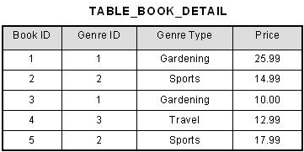
EXAMPLE
Consider the following example:
Is the relation in 3NF?

Slide 69
EXAMPLE
FD’s:
  Book ID → {Genre ID, Genre Type, Price } and
  Genre ID → Genre Type.
Therefore, Book ID determines Genre Type via Genre ID and we have transitive functional dependency.
Therefore this relation does not satisfy third normal form.

Slide 70
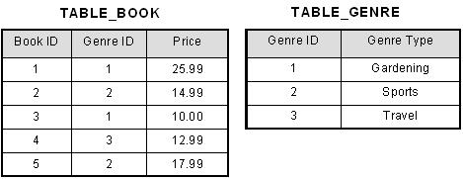
EXAMPLE
To bring this table to third normal form, we split the table into two as follows:

Slide 71
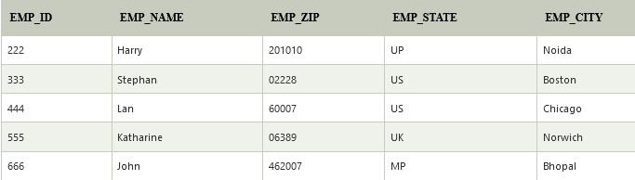
EXAMPLE
EMPLOYEE_DETAIL table:
Is the relation in 3NF?
Candidate key: {EMP_ID}
Non-prime attributes: In the given table, all attributes except EMP_ID are non-prime.
FD’s:
  EMP_ID → { EMP_NAME, EMP_ZIP, EMP_STATE, EMP_CITY}
  EMP_ZIP → {EMP_STATE, EMP_CITY}

Slide 72
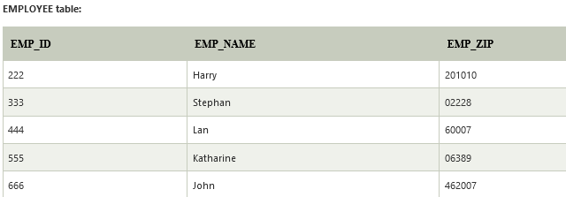
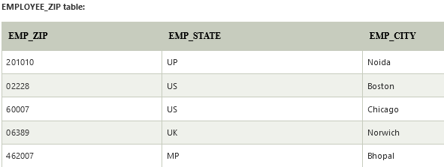
EXAMPLE
Here, EMP_STATE & EMP_CITY dependent on EMP_ZIP and EMP_ZIP dependent on EMP_ID.
The non-prime attributes (EMP_STATE, EMP_CITY) are transitively dependent on key(EMP_ID). It violates the rule of third normal form. That's why we need to move the EMP_CITY and EMP_STATE to the new <EMPLOYEE_ZIP> table, with EMP_ZIP as a Primary key.

Slide 73

EXAMPLE
A bank uses the following relation:
Is the relation in 3NF?
SOLUTION :
1NF - All attributes are single valued (1NF). Therefore the relation is in 1NF.
Key – {ID}

Slide 74
EXAMPLE
The following FD’s exist:
  ID --> Name, Account_No, Bank_Code_No,Bank
  Bank_Code_No --> Bank (Bank is functionally dependent on )
2NF - No partial dependencies exist. Therefore the relation is in 2NF.
3NF - there is a transitive dependency. Non prime attribute Bank is transitively dependent on key. Therefore the relation is NOT in 3NF.

Slide 75
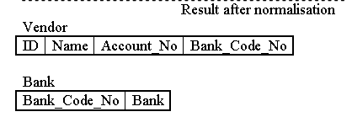
EXAMPLE

Slide 76
BCNF – Boyce Codd Normal Form
Boyce-Codd Normal Form or BCNF is an extension to the third normal form, and is also known as 3.5 Normal Form.
BCNF is stricter than 3NF.
For a table to satisfy the Boyce-Codd Normal Form, it should satisfy the following two conditions:
    It should be in the Third Normal Form.
    And, for any dependency A → B, A should be a super key.
For BCNF, the table should be in 3NF, and for every FD, LHS is super key.
Notes:
For BCNF, the table should be in 3NF, and for every FD, LHS is super key.

Slide 77
BCNF – Boyce Codd Normal Form
Decomposition into BCNF
When a table is in 3NF, it may or may not be in the Boyce Codd Normal Form. Each table/relation will have a set of functional dependency. If the FD does not satisfy the second condition of BCNF, the table is decomposed (breaking into smaller tables) recursively until all the functional dependency meets the super key criteria.
The algorithm to be followed for decomposition is:
  Determine the functional dependency that violates the BCNF.
  For every functional dependency X->Y which violates, decompose the relation into R-Y and XY. Here R is a relation.
  Repeat until all the relations satisfy BCNF.
Notes:
For BCNF, the table should be in 3NF, and for every FD, LHS is super key.

Slide 78
BCNF – Boyce Codd Normal Form
Decomposition into BCNF
When a table is in 3NF, it may or may not be in the Boyce Codd Normal Form. Each table/relation will have a set of functional dependency. If the FD does not satisfy the second condition of BCNF, the table is decomposed (breaking into smaller tables) recursively until all the functional dependency meets the super key criteria.
The algorithm to be followed for decomposition is:
  Determine the functional dependency that violates the BCNF.
  For every functional dependency X->Y which violates, decompose the relation into R-Y and XY. Here R is a relation.
  Repeat until all the relations satisfy BCNF.
Notes:
For BCNF, the table should be in 3NF, and for every FD, LHS is super key.

Slide 79
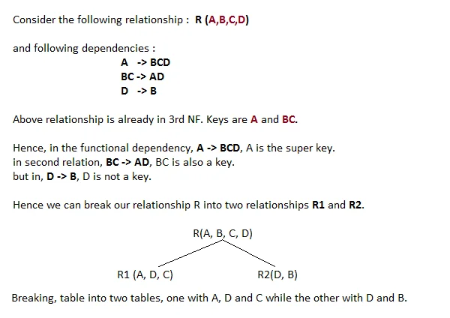
BCNF – Example

Slide 80
BCNF – Example
Example #1
Let’s consider a Relation R with five attributes
R=ABCDE
The functional dependencies are
FD = {A -> BC, C -> DE)
Candidate keys are {A}
Is the relation n BCNF ?
Notes:
For BCNF, the table should be in 3NF, and for every FD, LHS is super key.

Slide 81
BCNF – Example
Inspect each of the FD to check whether it satisfies the second condition of BCNF as it is in 3NF.
  The first FD A -> BC does not violate BCNF --------- since A is a key for R.
  Second FD C -> DE violates BCNF ----------- since C is not a key of R
We decompose R into R1 {A,B,C} and R2 {C,D,E}.
The two schemas are created with the FD attributes which violates and the other with original attributes minus the right-hand side of the violating FD.
Now we will check both the newly created relations to check whether they are in BCNF or not. A is the key in (ABC), and C is the key (CDE) they do not violate BCNF. Thus the relation is in BCNF.

Slide 82
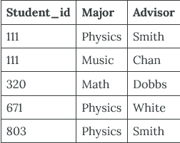
BCNF – Example
Consider the following table (St_Maj_Adv).
The functional dependencies for this table are listed below
  Student_id, Major ——> Advisor
  Advisor ——> Major
PK can be Student_id, Major or Student_id, Advisor.

Slide 83
BCNF – Example
Consider the following table (St_Maj_Adv).
The functional dependencies for this table are listed below
  Student_id, Major ——> Advisor
  Advisor ——> Major
Notes:
PK can be Student_id, Major or Student_id, Advisor.

Slide 84
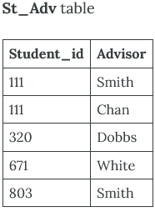
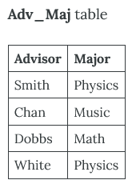
BCNF – Example
The functional dependencies for this table are listed below
  Student_id, Major ——> Advisor – satisfies BCNF as {Student_id, Major} is a superkey
  Advisor ——> Major violates BCNF as {Advisor} is not a superkey
To reduce the St_Maj_Adv relation to BCNF, you create two new tables:
  St_Adv (Student_id, Advisor)
  Adv_Maj (Advisor, Major)
Notes:
PK can be Student_id, Major or Student_id, Advisor.

Slide 85
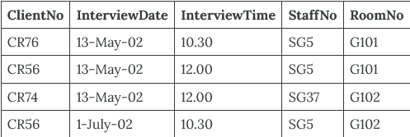
BCNF – Example
  Consider the following table (Client_Interview):
  FD1 – ClientNo, InterviewDate –> InterviewTime, StaffNo, RoomNo
  FD2 – staffNo, interviewDate, interviewTime –> clientNO
  FD3 – roomNo, interviewDate, interviewTime –> staffNo, clientNo
  FD4 – staffNo, interviewDate –> roomNo
  Is the table in BCNF?
Notes:
PK can be Student_id, Major or Student_id, Advisor.

Slide 86
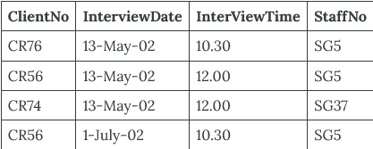
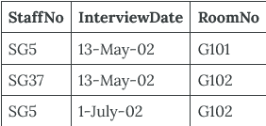
BCNF – Example
  A relation is in BCNF if, and only if, every determinant is a superkey. We need to create a table that incorporates the first three FDs (Client_Interview2 table) and another table (StaffRoom table) for the fourth FD.

Slide 87
https://www.javatpoint.com/dbms-second-normal-form
https://www.geeksforgeeks.org/normal-forms-in-dbms/
https://www.studytonight.com/dbms/second-normal-form.php
https://beginnersbook.com/2015/05/normalization-in-dbms/
https://www.guru99.com/database-normalization.html
http://www.gitta.info/LogicModelin/en/html/DataConsiten_Norm3NF.html
https://www.1keydata.com/database-normalization/third-normal-form-3nf.php

